Slide 1
L&d live connect
BASICS OF PYTHON+ PANDAS
PRESENTED BY :
MANISH CHAUHAN
Friday,3rd December 2021

Slide 2
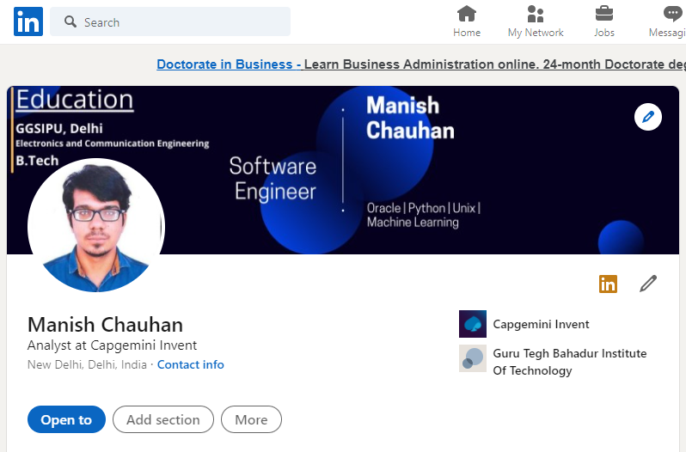
ABOUT ME
Designation: Senior Analyst
Department : DRR, Capgemini Invent
Technologies: Oracle PLSQL, Python, Machine Learning, Shell Scripting, Tableau.

Slide 3

The first step in data analysis

Slide 4
What is Data analysis?
1

Slide 5
Data analysis
Data analysis is a process of inspecting, cleansing, transforming, and modelling data with the goal of discovering useful information, informing conclusions, and supporting decision-making

Slide 6
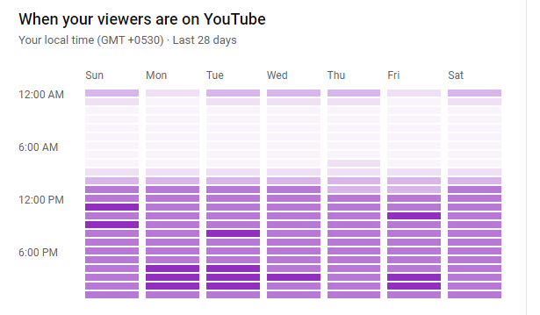
Data analysis

Slide 7
INTRODUCTION OF PYTHON
2

Slide 8
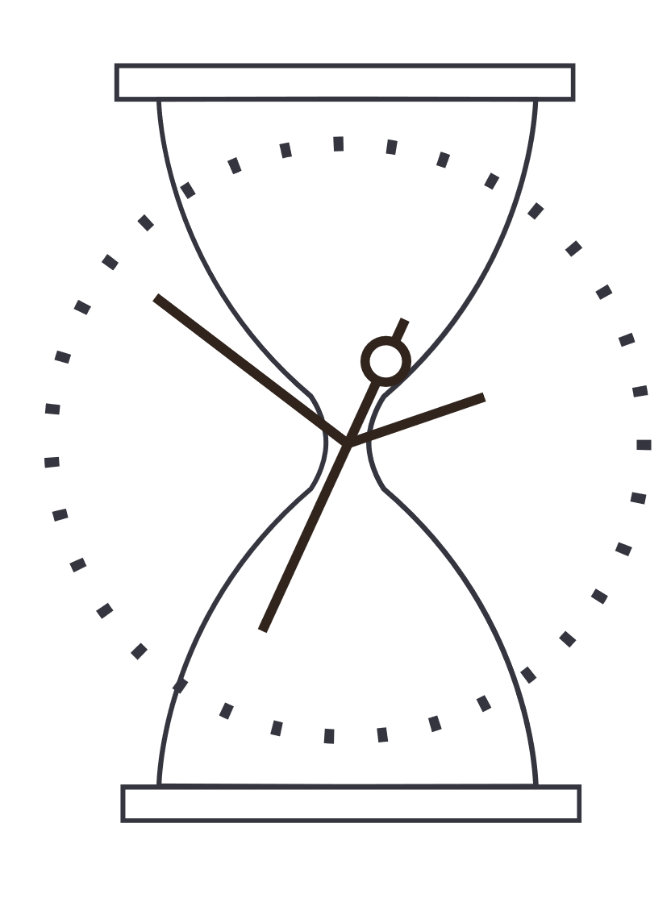

history
Python Is A Programming Language
It Was Created By Guido Van Rossum, And Released In 1991

Slide 9
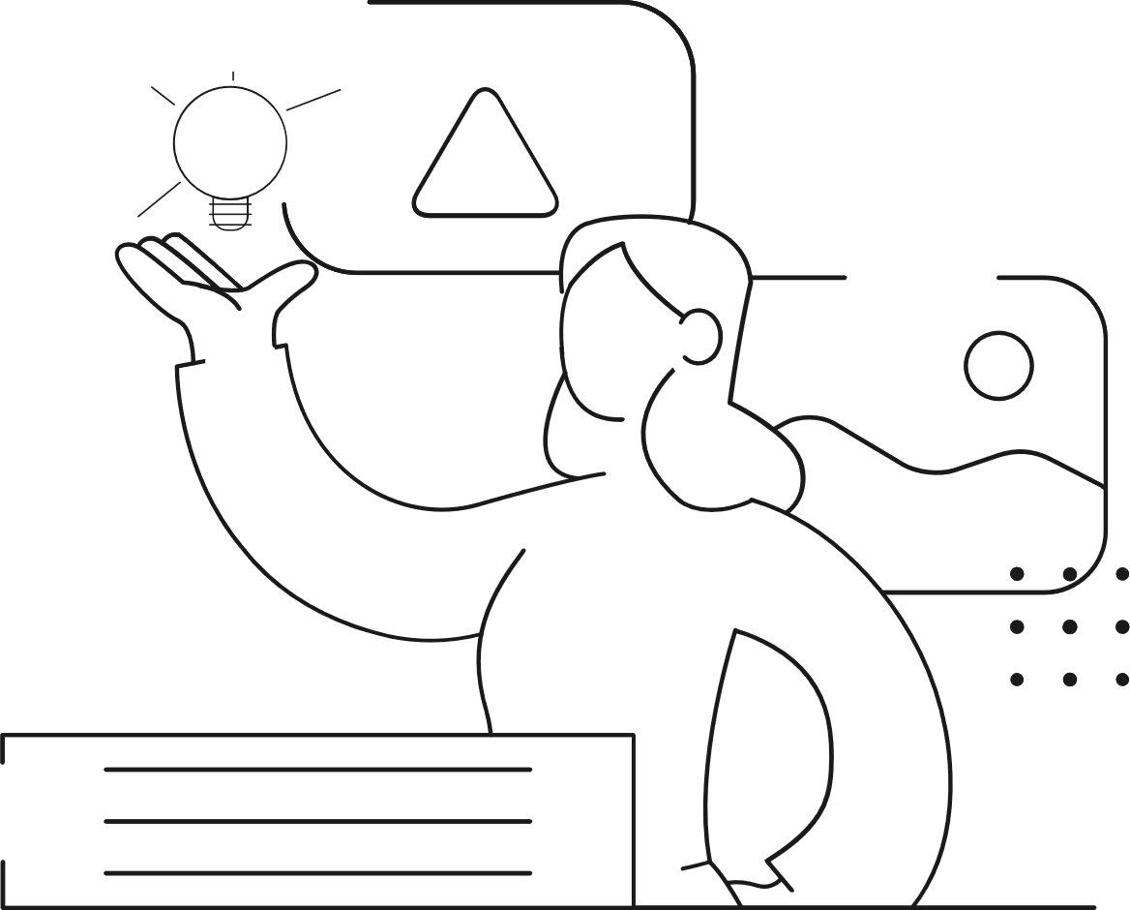

HOW TO WRITE CODE ?
Install Python Directly
Install Anaconda Navigator
Use Google Collab Cloud Repository
Practise On Kaggle Notebooks

Slide 10
Pandas library in python
3

Slide 11
What is pandas ?
pip install pandas
Pandas is defined as an open-source library that provides high-performance data manipulation in Python. The name of Pandas is derived from the word Panel Data, which means an Econometrics from Multidimensional data. It is used for data analysis in Python and developed by Wes McKinney in 2008.

